Slide 1

Private Water Systems in the State of Minnesota
Applying knowledge and experience to provide safe, sustainable groundwater
David Henrich CWD/PI, CVCLD
President, MWWA
President, Bergerson – Caswell, Inc.

Slide 2
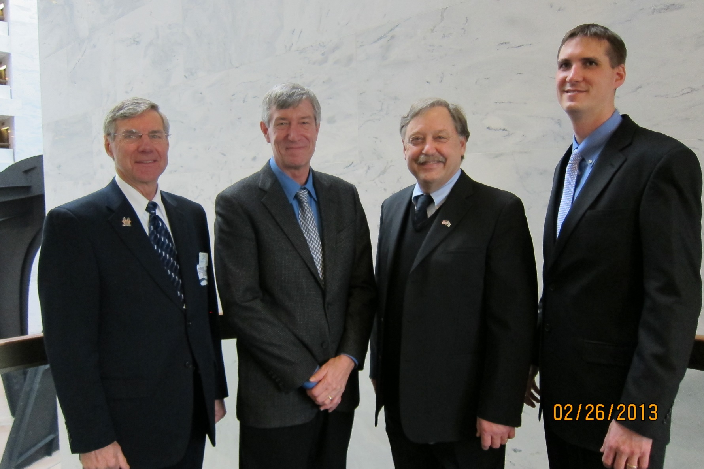
The Minnesota Water Well Association
175 Members, 98 years, Providing education for almost 100 years
Dave Schulenberg, QAS
Director of Affiliate Services Group - NGWA
Executive Director of:
California Groundwater Association
Illinois Association of Groundwater Professionals
Michigan Ground Water Association
Minnesota Water Well Association
Montana Water Well Drillers Association

Slide 3
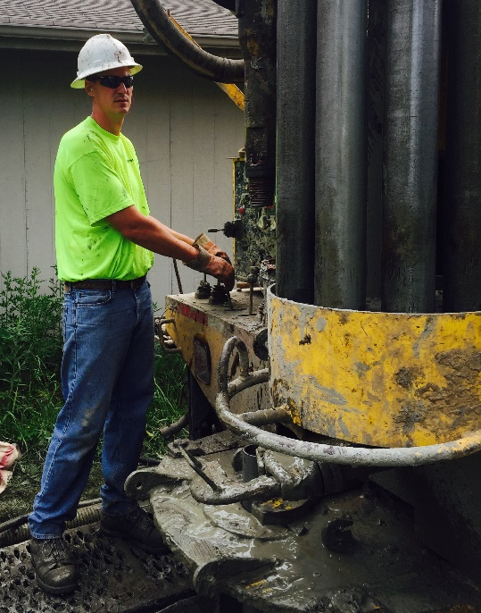
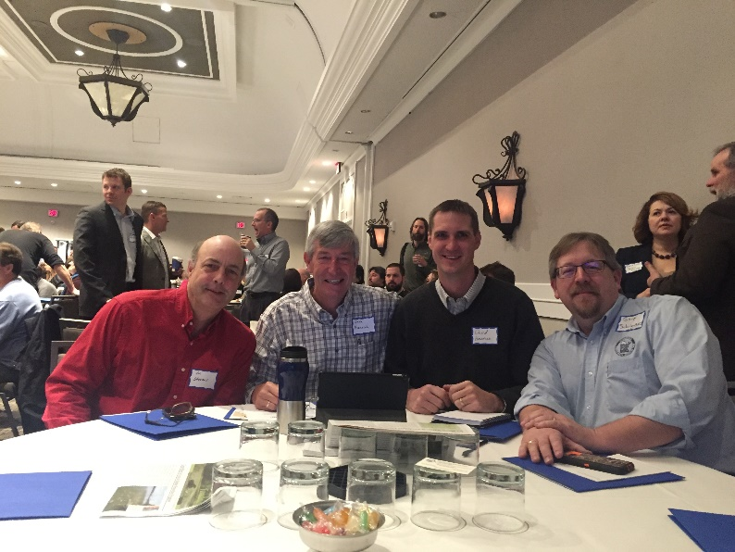
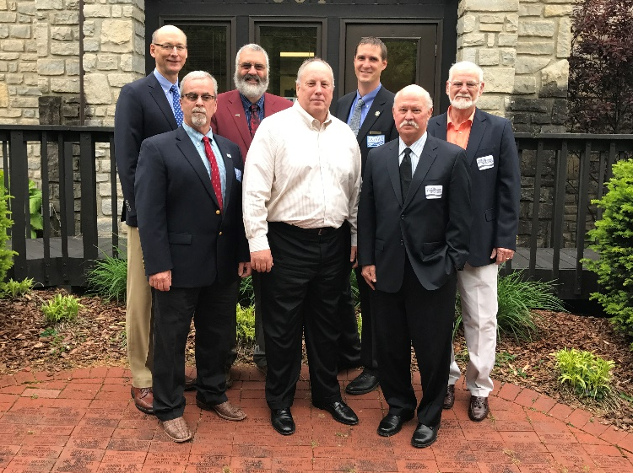
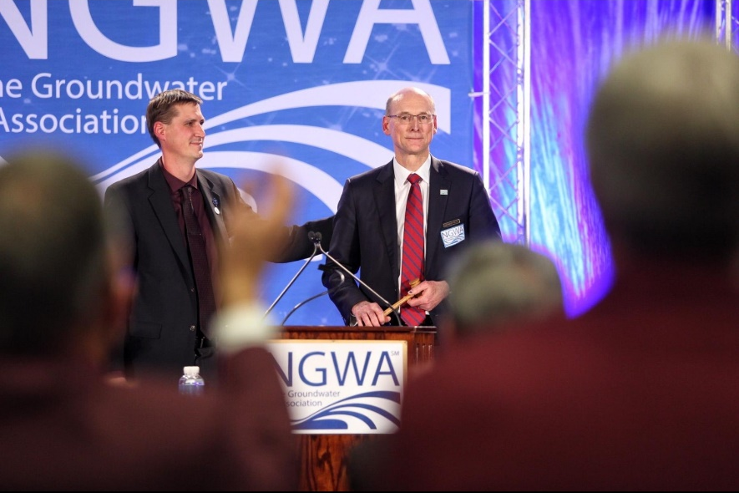
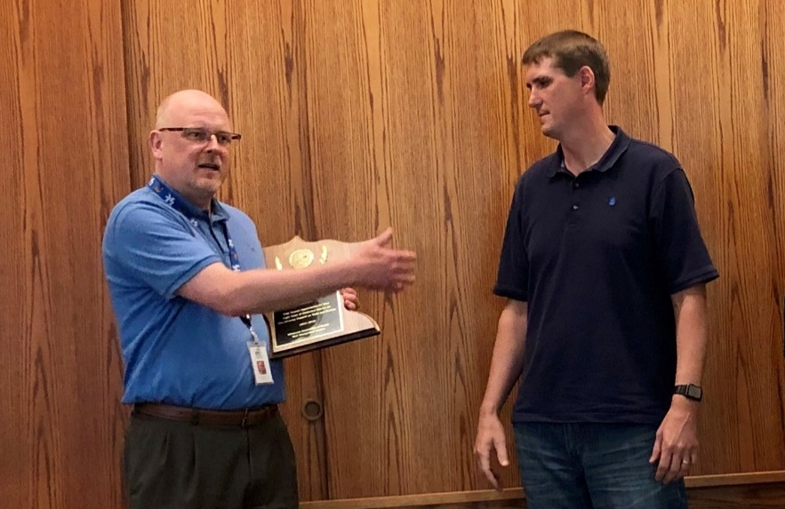
David Henrich - CWD/PI, CVCLD, CGDIT
Professional Activities
President - Bergerson-Caswell, Inc.
Vice President - Thermal Dynamics, Inc.
Vice President - Precision Geothermal, llc.
Past President - NGWA Board of Directors
President - MWWA Board of Directors
Notes:
Talk about NGWA 11,000 member association of Contractors, Scientists, suppliers and manufacturers all dedicated to the protection and responsible use of groundwater. Have many BSPs, papers, journals and ANSI Standard as well as many dedicated volunteers that are constantly working on groundwater topics. Currently there is a very active group working on PFAS remediation.
MWWA is primarily a contractors organization but it too has a similar mission to the NGWA. Without groundwater there won’t be an industry to advocate for.

Slide 4
Water Wells in the State of Minnesota
Water wells in the state of Minnesota
  Wells as a modern resource
  State agencies and the state well code
  The well contracting community
Things homeowner’s should know
  Water testing
  Well maintenance
  Seal unused wells
SMART Water Policy
  Who owns the water?
  Proper use of the right resource
Q & A

Slide 5
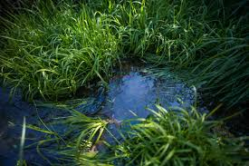
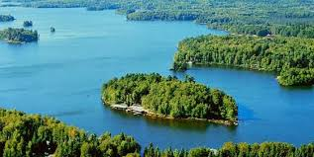
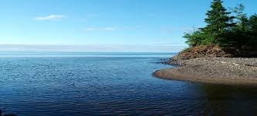
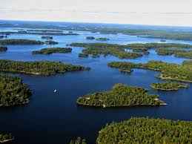
Water in the State of Minnesota

Slide 6
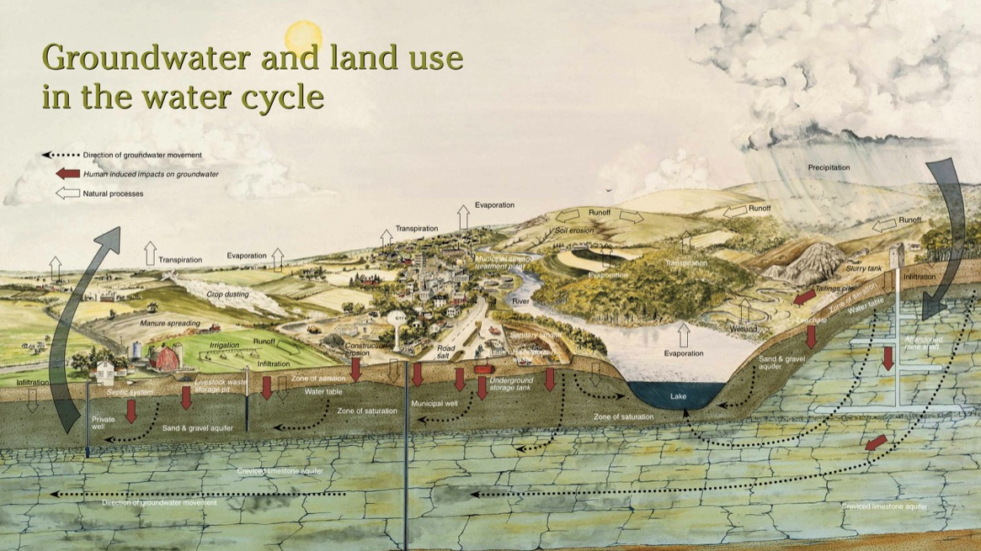

Slide 7
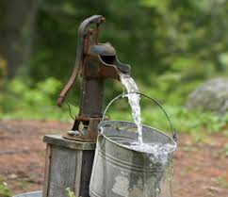
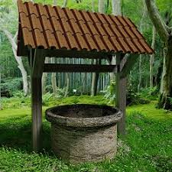
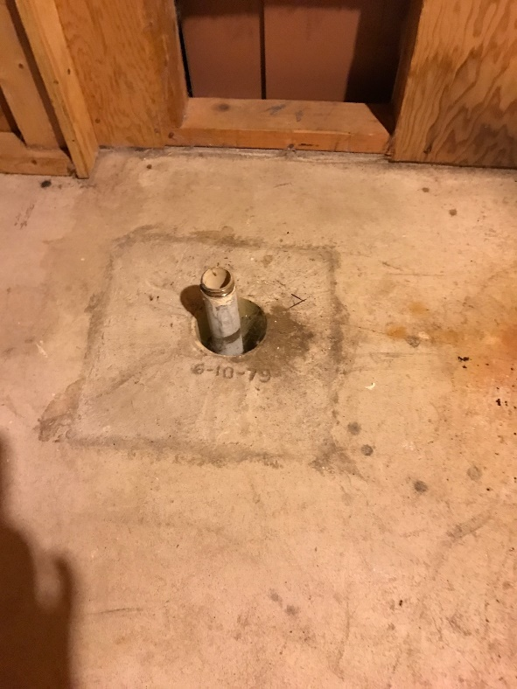
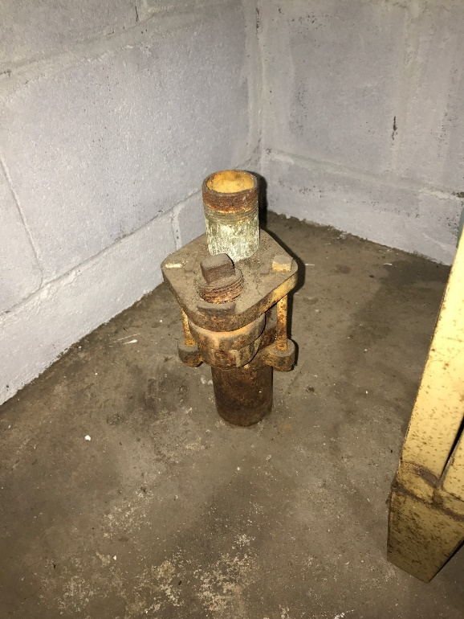
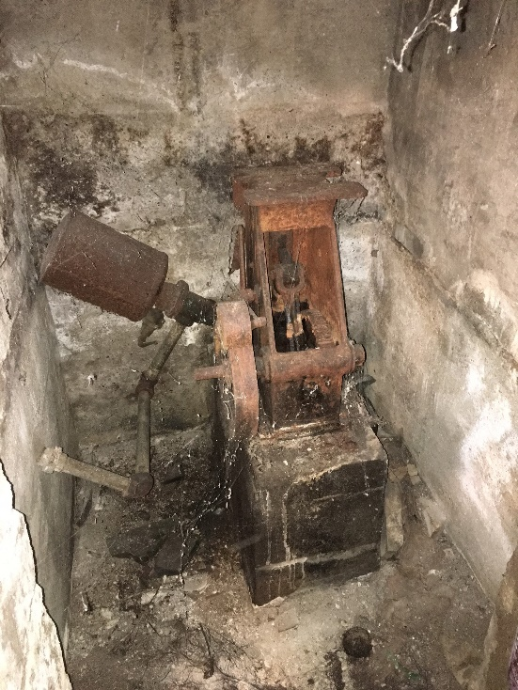
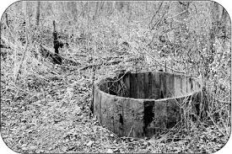
Private Water Systems in the State of Minnesota

Slide 8
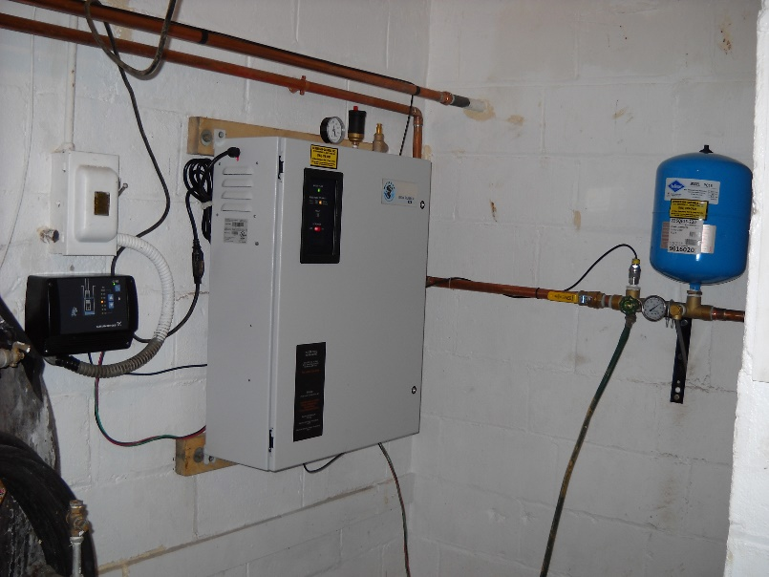
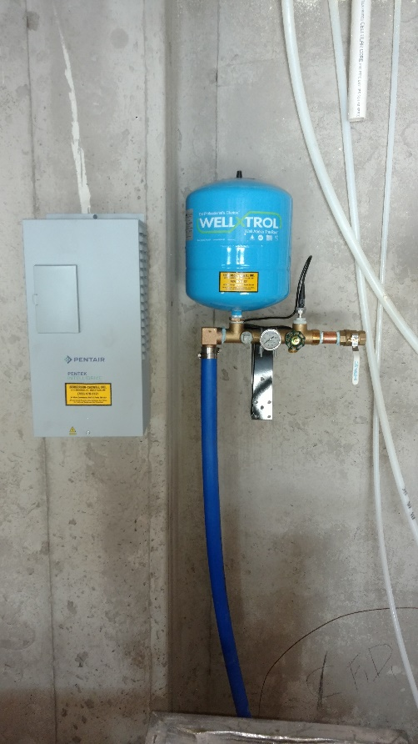
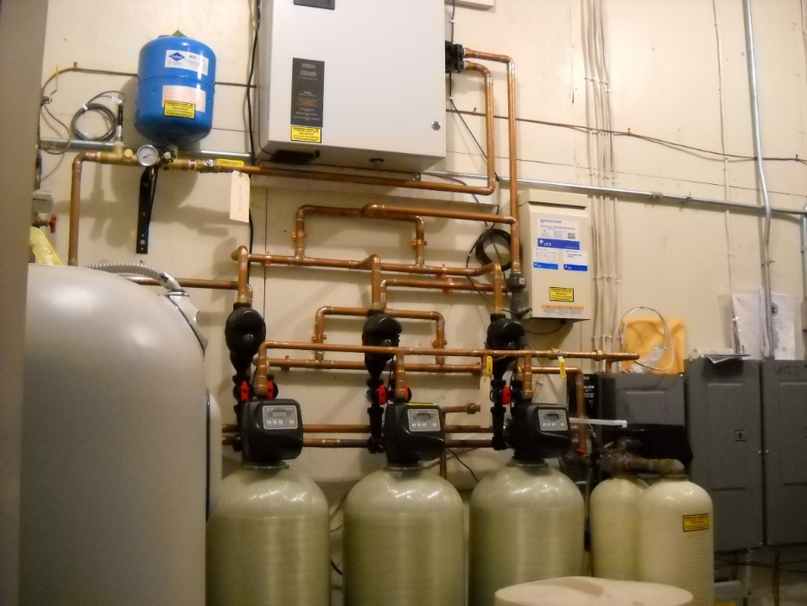
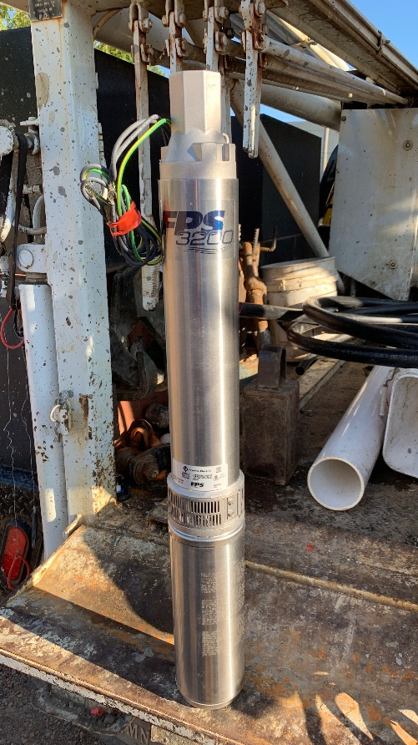
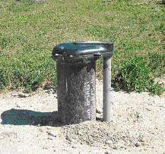
Private Water Systems in the State of Minnesota

Slide 9
Private Water Systems in the State of Minnesota
Modern private water systems
Wells constructed to a nationally leading standard
Reliable and low cost of operation
Installed by trained professionals
Water efficient
Constant pressure
Capable of being internet connected
100% natural

Slide 10
Great Professionals and Standards
MN well code statute first adopted in 1974, last revised in 2008, rules continually refined
  Statute 4725 is 103 pages, MDH Guide book is 603 pages
  Thorough, logical, good enforcement model, 98% compliance
  Nationally recognized
  Grouting rules improved environmental protection and drinking water quality – Nitrates in SE MN
  Eliminated multi-aquifer wells
  Annual continuing education, including 2 hours of direct contact from MDH
  NSF approved materials
  Isolation distances from potential contaminates
  Special well construction areas
Aggressive well sealing program for non-code and unused wells
  Sealed around 300,000 wells
  National recognized and awarded effort
Bottom Line: Our code is a national leader and our compliance is stellar

Slide 11
Minnesota Agencies Dealing with Groundwater
Minnesota Department of Health - Wells and borings used for drinking water, irrigation, industry, groundwater monitoring, heat pumps, hydraulic elevators, and other purposes must be properly constructed, maintained, and sealed (filled with an impervious material) when removed from service, to protect both public health and our invaluable groundwater resources. The Minnesota Department of Health's Well Management Program protects both public health and groundwater by assuring the proper construction of new wells and borings, and the proper sealing of unused wells and borings. health.state.mn.us/divs/eh/wells/index.html
Minnesota Department of Natural Resources - Groundwater supplies 75 percent of Minnesota's drinking water and 90 percent of agricultural irrigation. Availability varies throughout the state and may be limited in areas for larger withdrawals. The DNR is primarily responsible for monitoring regulating groundwater withdrawal state wide. dnr.state.mn.us/waters/groundwater_section/index.html

Slide 12
Minnesota Agencies Dealing with Groundwater
MPCA - The Minnesota Pollution Control Agency helps protect our water by monitoring its quality, setting standards and controlling what may go into it. pca.state.mn.us/water
MDA - Focuses on groundwater quality protection for agriculture throughout the state of Minnesota. The have a heavy focus on preventing agricultural byproduct migration into groundwater. mda.state.mn.us
USGS - The USGS Minnesota Water Science Center is your source for water-resource information collected and interpreted by the U.S. Geological Survey in Minnesota. mn.water.usgs.gov
Other organizations regulating groundwater – soil and water conservation districts, water shed districts, Met Council, Municipalities?

Slide 13
Minnesota’s Water Well Community
Currently there are 545 licensed contractors to install and service water wells in Minnesota
Played an integral part in developing the states well construction code
The Minnesota Groundwater Contractors regularly churn out national leaders
  7 NGWA presidents, 4 since 2000 – Roger Renner 2000, Jack Henrich 2008, Richard Thron 2014, David Henrich 2018
  Three McEllhiney lecturers - Peter Cartwright 2016, Dave Kill 2005 (Current AGWT Board chair), Dave Hansen 2003
Worked with Rep. McCollum to authorize and fund the National Groundwater Monitoring Network
Regularly sponsor and attend the Water Festivals around the state
Lead countless hours of educational outreach inside and out of the industry

Slide 14
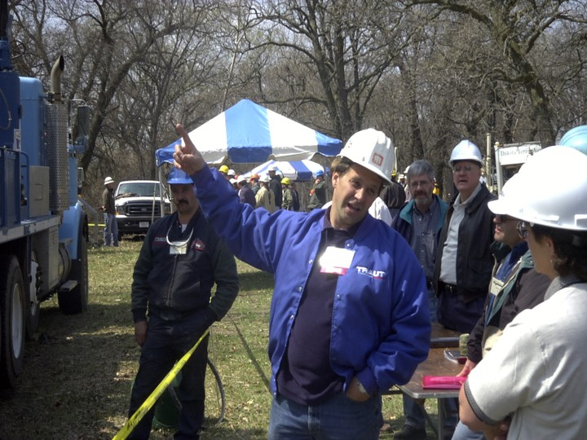
What Can Well Owners Do?
You are your water department,
Well Contractors are your resource.
To ensure safe drinking water:
  Test your water annually
  Inspect your well regularly
  Service water conditioning equipment
  Seal unused wells

Slide 15
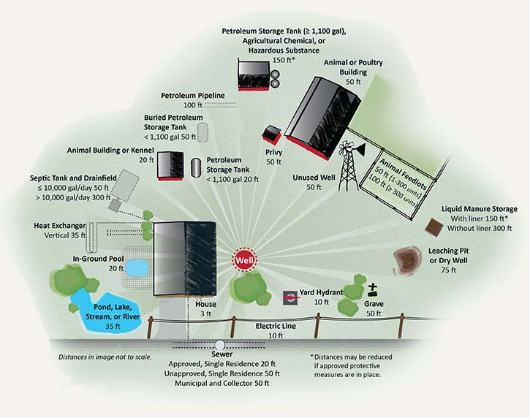
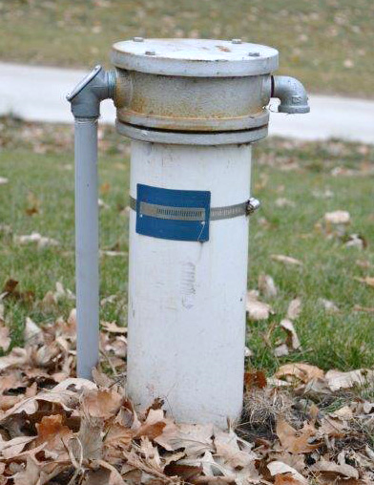
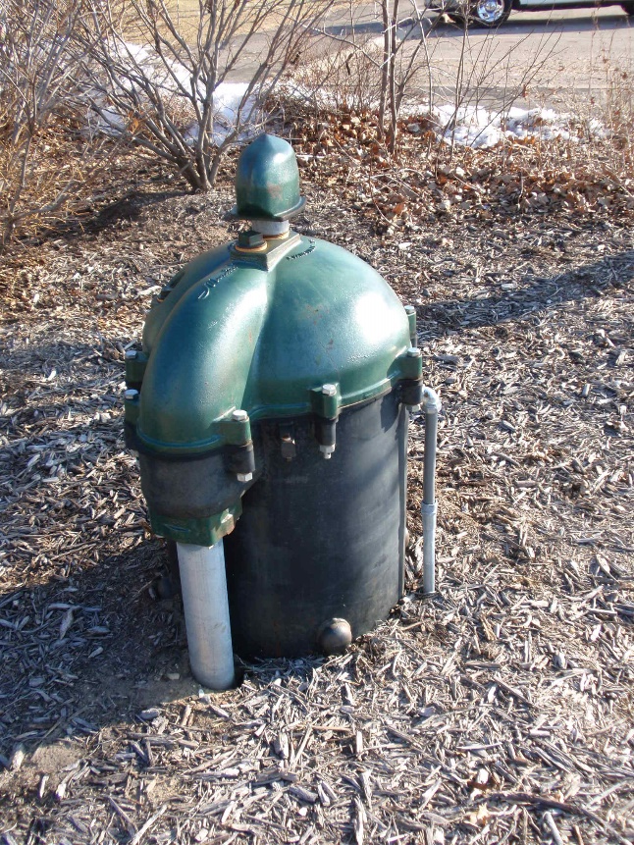
Inspect Your Well Regularly
Right!
Source: MDH

Slide 16
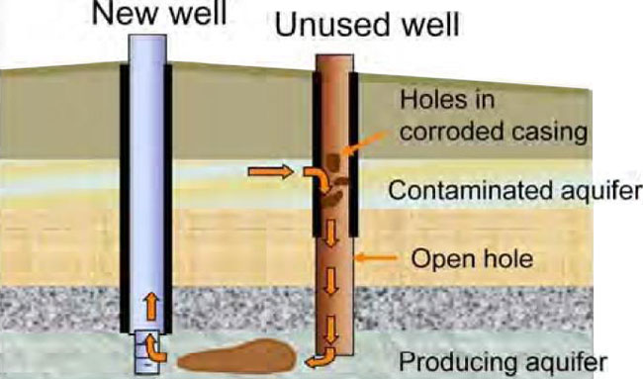
Seal Unused Wells
Sealing unused wells protects you and the environment
Unused wells must be sealed by code
Much easier to seal intact wells
Grants and low interest loans may be available
CWF money for voluntary well sealing?
Only can be completed by licensed well contractors
Reference the MDH Wells and Borings website for more info

Slide 17
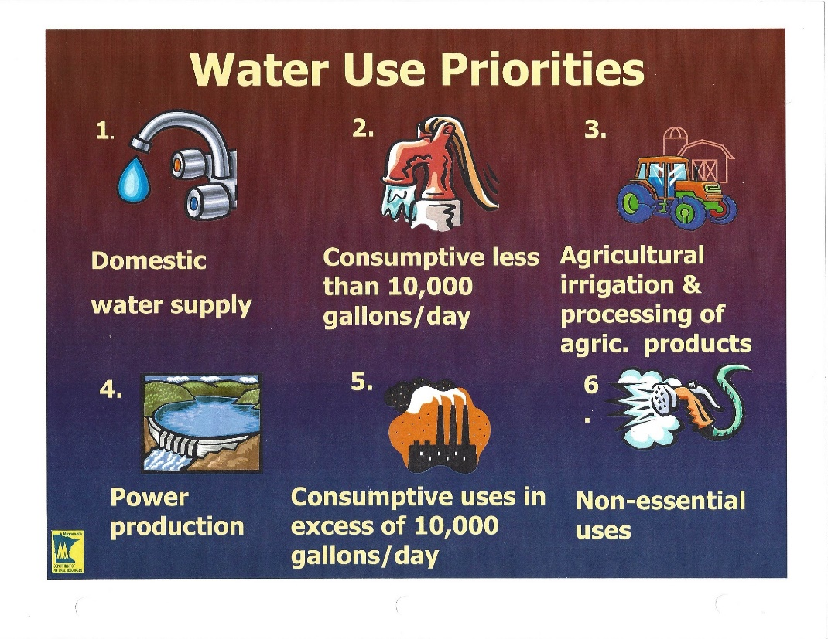
Private Water Systems in the State of Minnesota
MN Water wells by the numbers:
73% Minnesotans get their water from a well
Over 1.2 million MN rely on private water systems
Nearly our entire ag industry relies on groundwater
MN remains one of the healthiest states in the country

Slide 18

Groundwater by the Numbers
Groundwater use - MN 2010
Groundwater use - MN 2015
MN GROUNDWATER USE
736 MGD
MN GROUNDWATER USE
776 MGD
Source: USGS Survey – 2010, 2015 provided by NGWA

Slide 19
Groundwater by the Numbers
2010 – MN Population 5.29 Million
2015 – MN Population 5.48 Million
Population served by groundwater: 4.1 Million
Public and private water: 432 mgd
  Consumption per capita: 105.4 gal/day
Agricultural consumption: 231.6 mgd
Private water systems: 78.8 mgd
  Consumption per capita: 66.8 gal/day
Public water systems: 353.2 mgd
  Consumption per capita: 118 gal/day
next
Population served by groundwater: 4.2 Million
Public and private water: 418.3 mgd
  Consumption per capita: 99.5 gal/day
Agricultural consumption: 302.6 mgd
Private water systems: 82.3 mgd
  Consumption per capita: 66.8 gal/day (Approx)
Public water systems: 336 mgd
  Consumption per capita: 112.2 gal/day
next
Source: USGS Survey – 2010, 2015 provided by NGWA

Slide 20
SMART Water Policy
MN has riparian rights and operates under reasonable use doctrine as defined under State statute 103A-I
Use the appropriate resource for the appropriate purpose
Tiered water rates only affect less affluent water users
Keep infrastructure manageable
Focus on land use and aquifer recharge
Work on chloride reduction
Mandatory water testing at property transfer

Slide 21
Conclusions
Minnesota’s standards are the best in the country
Minnesota has one of the most comprehensive well management systems in the country
Wells constructed to Minnesota’s standards are not contamination sources
The well contracting community has been delivering quality water for a very long time
Private water systems are the most efficient water delivery systems in Minnesota
Private water systems are a much more carbon friendly for high volume water users
Our Ask:
The water well industry in Minnesota has been a faithful servant of the citizens of Minnesota. Please consider the impact on this crucial industry when enacting legislation.

Slide 23

Questions?
David Henrich
763-479-3121
david@bergersoncaswell.com
Dave Schulenberg
800-332-2104
dschulenberg@ngwa.org

